Slide 1
Win Your Life
Django Fett Team

Slide 2

Do you have control over your habits?
Hustle culture becomes more and more popular among people around the world. There is one issue. Learning how to be productive without taking action is a non productive activity.

Slide 3

You have to take action in your life!
If you want to change your life, you have to add new habits to your life! You have to define the activities that, repeated daily, will change your reality.

Slide 4

Things are not that simple as they seem!
There are many to-do lists are supposed to help you develop a new habit. Unfortunately, people fail to use them daily for longer time. Overall, applications neither punish for failure to complete a task, nor reward in the event of success.

Slide 5
There is a solution!

Slide 6
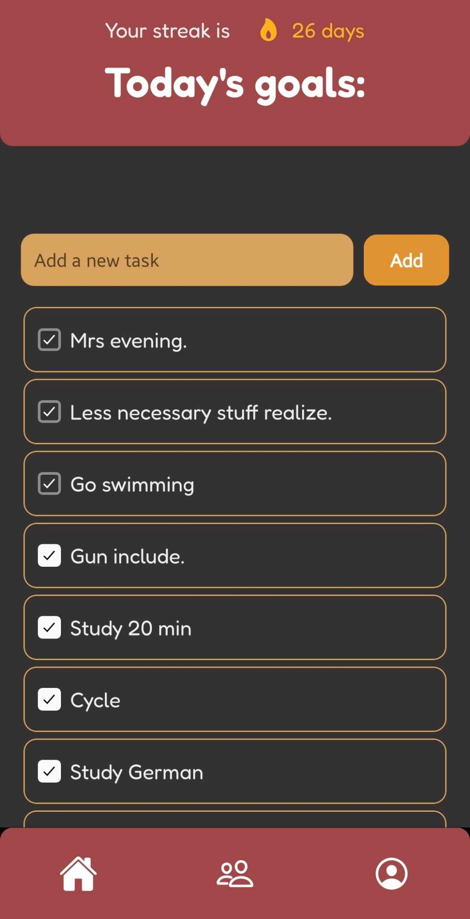
Keep your habits everyday!
Activities in your to-do list repeat everyday so you always know what to do!
Add all habits that make your ideal day!
Keep your streak as high as possible and make your life better!

Slide 7
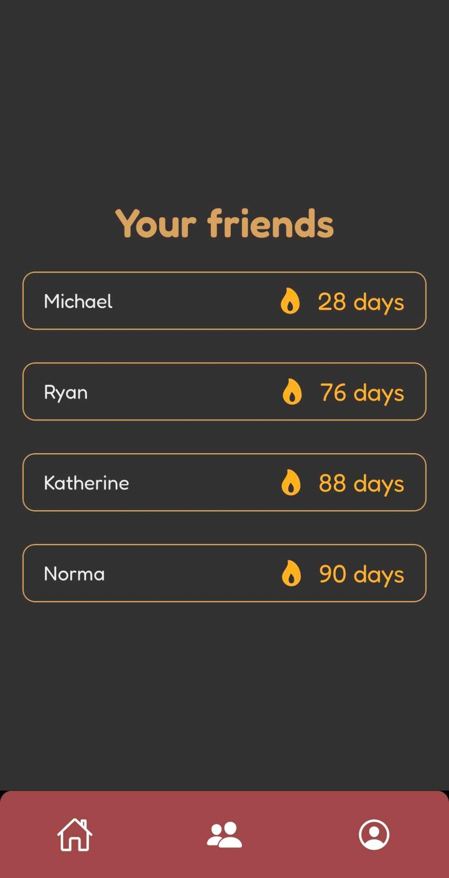
Don’t be lazy towards your friends!
Add your friends to know how they are doing!
Keep yourself motivated by keeping streak with your friends

Slide 8
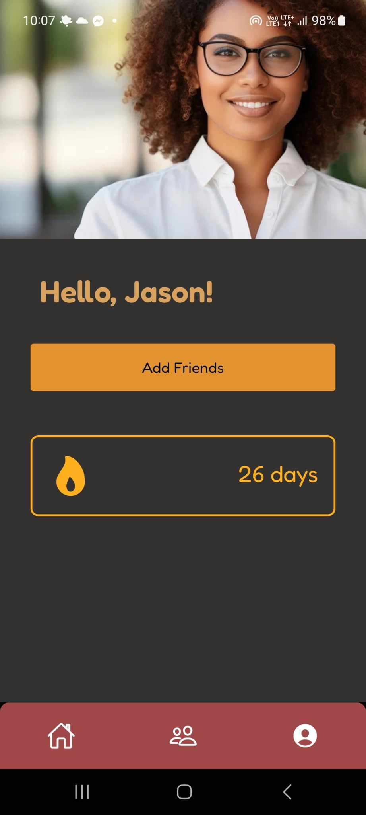
Track all the information you need
Track information about your good and bad days
Always have a good day!
Win your life with us!

